Slide 1
Introduction to Classification
Srikanth Gunturu

Slide 2
In this segment
Introduction to Classification
What is a Classification ?
Classification – Process and a few terms
Classification Model – Uses & General Approach

Slide 3
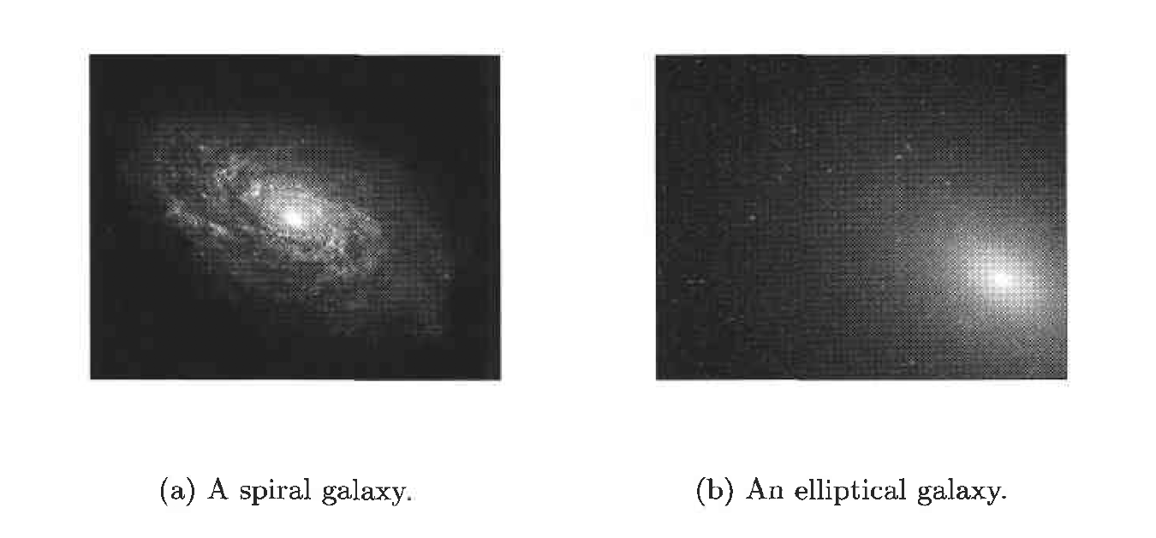
Introduction to Classification
What is Classification
The task of assigning objects to one of several predefined categories (classes)
Real world applications of classification
Detecting spam email messages based upon the message header and content
Categorizing tumours as malignant or benign based upon the results of MRI scan
Classifying galaxies based upon their shapes

Slide 4
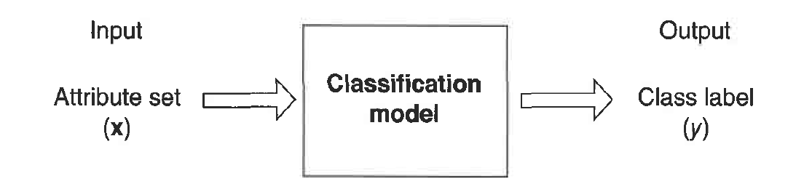
Introduction to Classification
Classification – Process and a few terms
Classification is the task of learning a target function f that maps each attribute set x to one of the predefined class Iabels y
Feature / Attribute – Input attribute that’s used in classifying the output
Feature set – Set of attributes that govern the output class
Label – Output class that the object is assigned to

Slide 5
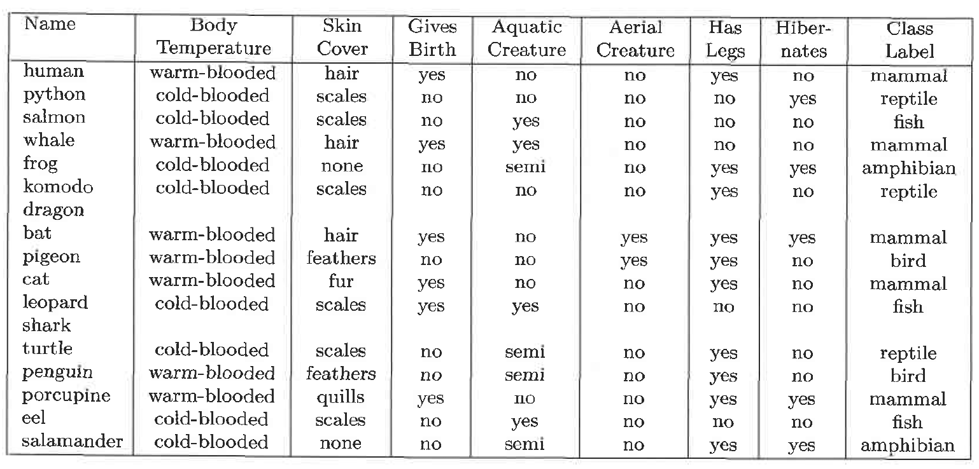
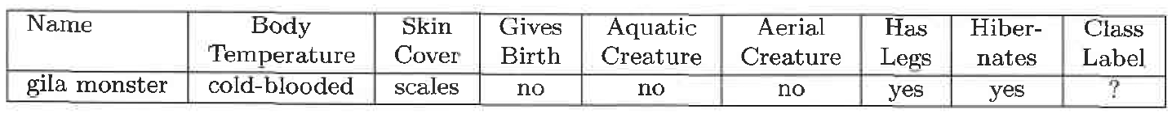
Introduction to Classification
Classification Model – Uses
Descriptive - Serves as an explanatory tool to distinguish between objects of different classes
Predictive – Used to predict the class label of unknown records

Slide 6
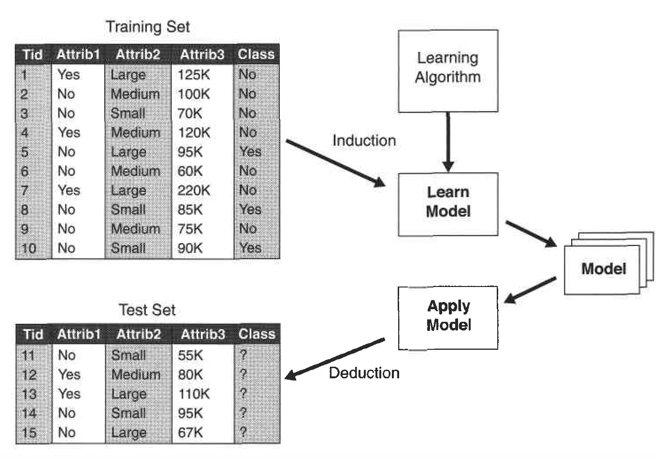
Introduction to Classification
Classification Model – General Approach
Should fit the input data well
Should correctly predict the class labels of records it has never seen before

Slide 7
Thank You!
In our next session:
Types of classification algorithms

